Slide 1


November 23, 2016

Slide 2

November 23, 2016

Slide 3
Linear Regression
or: How I Learned to Stop Worrying and Love Data Science
[A work of possibly some fiction]
November 23, 2016

Slide 4
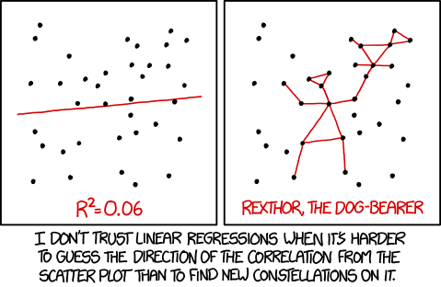
What is linear regression?
Notes:
Next up: The top five Google hits for this question

Slide 5
What is linear regression?
1) https://en.wikipedia.org/wiki/Linear_regression
2) http://www.statisticssolutions.com/what-is-linear-regression/
3) http://onlinestatbook.com/2/regression/intro.html
4) http://www.stat.yale.edu/Courses/1997-98/101/linreg.htm
5) http://people.duke.edu/~rnau/regintro.htm

Slide 6
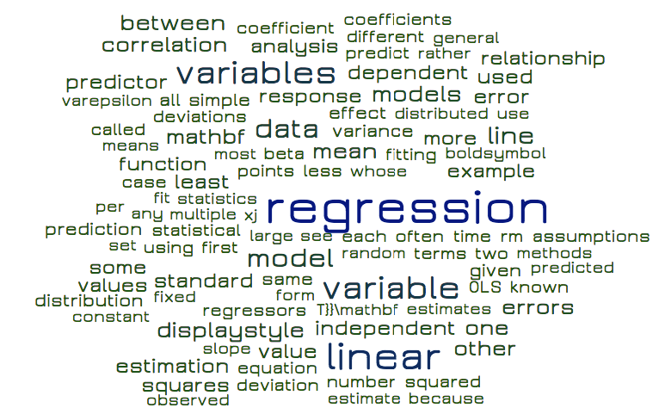
Notes:
Next up: Math Boyfriend

Slide 7
Notes:
Next up: To talk about linear regression we need to first talk about regression in general

Slide 8
Linear Regression

Slide 9
Linear Regression

Slide 10
The term "regression" was coined by Francis Galton in the nineteenth century to describe a biological phenomenon: the heights of descendants of tall ancestors tend to regress down towards a normal average (a phenomenon also known as “regression towards the mean”).

Slide 11
In statistical modeling, regression analysis is a process for estimating the correlation relationships among variables where a target (aka ‘dependent’) variable is determined by one or more predictor (aka ‘independent’) variables.

Slide 12
This relationship is encapsulated in the “beta” for your predictor, aka:
The coefficient
The amount your predictor value is multiplied by to get your target value.
Notes:
Next up: this is a loss function

Slide 13
More specifically, regression analysis explains how the average value of the target variable changes when any individual predictor variable is varied as the other predictor variables are held fixed.
Notes:
Next up: this value is encapsulated in our “beta”

Slide 14
LOSS or COST function
Notes:
Next up: definition

Slide 15
LOSS function
In mathematical optimization, statistics, decision theory and machine learning, a loss function or cost function is a function that maps an event or values of one or more variables onto a real number intuitively representing some "cost" associated with the event.
Notes:
Next up: bringing back the original regression explanation to highlight “average” return

Slide 16
More specifically, regression analysis explains how the average value of the target variable changes when any individual predictor variable is varied as the other predictor variables are held fixed.

Slide 17
Regression attempts to minimize the loss function.
Notes:
In other words: It attempts to minimize the amount of difference (residuals, errors), while also preserving predictive value: too specific and you’re overfitting. Not specific enough and you’re underfitting.
Next up: review the 3 aspects of regression

Slide 18
Estimate the relationships between predictor and target variables

Slide 19
Estimate the relationships between predictor and target variables
Incurs loss as a result of this estimation

Slide 20
Estimate the relationships between predictor and target variables
Incurs loss as a result of this estimation
Attempts to minimize loss

Slide 21
Linear Regression

Slide 22
Linear Regression

Slide 23
What is linear regression?
1635-45; < Latin līneāris - of, belonging to lines

Slide 24
What is linear regression?
1635-45; < Latin līneāris - of, belonging to lines
Linear regression attempts to model the relationship between two variables by fitting a linear equation to observed data.
Is a statistical method that allows us to summarize relationships between two continuous (quantitative) variables.
Is the most widely used of all statistical techniques, which studies linear, additive relationships between variables.
A mathematical technique for finding the straight line that best-fits the values. This line can be used for estimating the future values of the function by extending it while maintaining its slope.

Slide 25
What is linear regression?
1635-45; < Latin līneāris - of, belonging to lines
The statistical and mathematical process by which we model the slope of the best-fit, additive relationship, represented by a plotted straight line, between two sets of continuous variables where one set determines or predicts the other, in order to estimate future values.

Slide 26
What is linear regression?
1635-45; < Latin līneāris - of, belonging to lines
The statistical and mathematical process by which we model the slope of the best-fit, additive relationship, represented by a plotted straight line, between two sets of continuous variables where one set determines or predicts the other, in order to estimate future values.

Slide 27
What is linear regression?
1635-45; < Latin līneāris - of, belonging to lines
Simple linear regression:
1 predictor variable

Slide 28
What is linear regression?
1635-45; < Latin līneāris - of, belonging to lines
Simple linear regression:
1 predictor variable
Multiple linear regression:
>1 predictor variable
Notes:
There’s also “multivariate linear regression,” which additionally involves multiple targets as well as predictors, but that’s out of scope for this presentation.

Slide 29
Ordinary Least Squares

Slide 30
The earliest form of regression was the method of least squares, which was published by Adrien Legendre in 1805 as he applied the method to the problem of determining, from astronomical observations, the orbits of bodies about the Sun.
The specific form used for linear regression is “Ordinary Least Squares,” which comes from the original French term, "méthode des moindres carrés".
Notes:
Next up: what a picture!

Slide 31

Notes:
This is going to be my next Halloween costume.
Next: what do we mean by “least squares”?

Slide 32
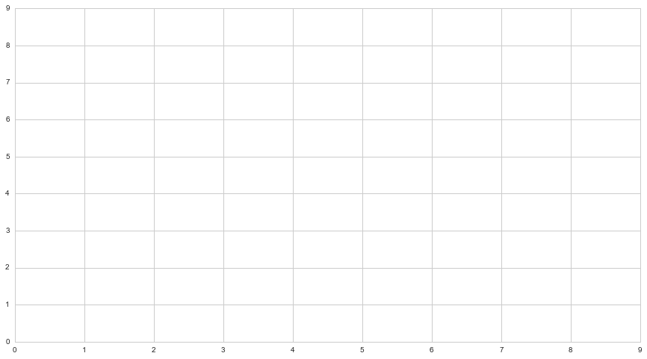

Slide 33
Notes:
How do we evaluate this line? Measure the sum of the squares of the residuals or errors.
This would have a pretty high “cost” or “loss” associated with it. The sum of residuals would be high.

Slide 34
Notes:
Next up: large residual or error values will mean your sum is large

Slide 35
Notes:
Adding the squares of these values will be a larger number.

Slide 36
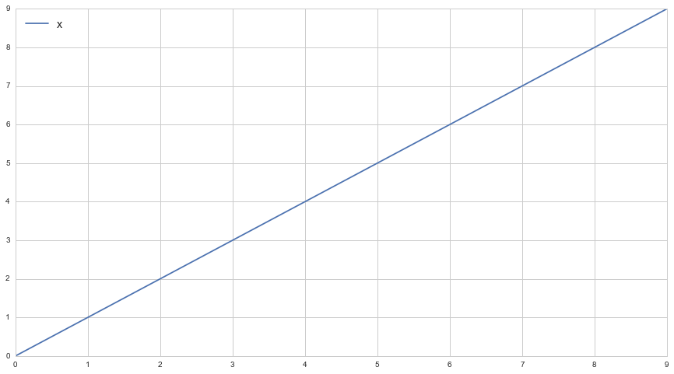

Slide 37
Notes:
This allows us to minimize our residuals - the sum of these residuals will be a lot less.
Next up: a quick review of overfitting and underfitting.

Slide 39
Overfitting

Slide 40
Underfitting
Notes:
Next up: Reframing under/over fitting as bias/variance trade-off
There are two basic groups of errors when it comes to predictive analysis: bias and variance

Slide 41
Bias and Variance

Slide 42
Bias
The bias (or bias function) of an estimator is the difference between the estimator's expected value and the true value of the parameter being estimated.
Notes:
NOTE: The bias of a linear regression is in the name - it expects there to be a linear relationship between the predictor and the target.

Slide 43
Bias
The bias (or bias function) of an estimator is the difference between the estimator's expected value and the true value of the parameter being estimated.
Bias is caused by the simplifying assumptions made by a model to make the target function easier to learn
Notes:
NOTE: The “simplifying assumption” of a linear regression is in the name - it expects there to be a linear relationship between the predictor and the target.

Slide 44
Bias
The bias (or bias function) of an estimator is the difference between the estimator's expected value and the true value of the parameter being estimated.
Bias is caused by the simplifying assumptions made by a model to make the target function easier to learn
Quicker and easier to model, at the potential expense of accuracy
Notes:
NOTE: The “simplifying assumption” of a linear regression is in the name - it expects there to be a linear relationship between the predictor and the target.

Slide 45
Variance
Variance is error from sensitivity to small fluctuations in the training set.

Slide 46
Variance
Variance is error from sensitivity to small fluctuations in the training set.
Can seductively resemble more “accuracy,” as it may seem to better fit your current data, but does so at the expense of being less accurate on new data

Slide 47
Variance
Variance is error from sensitivity to small fluctuations in the training set.
Can seductively resemble more “accuracy,” as it may seem to better fit your current data, but does so at the expense of being less accurate on new data
More flexibility with form, less assumptions made about the data

Slide 48
Bias vs Variance
Tend to be inverses of each other - as one increases, the other decreases.

Slide 49
Bias vs Variance
Tend to be inverses of each other - as one increases, the other decreases.
The trick is balance where they are both as minimized as possible.
Notes:
NOTE: Literally variance is defined as between predictions on various sets of data, not within one measurement, but you can see it in your line also…
ALLUDED to: test-train-split

Slide 50
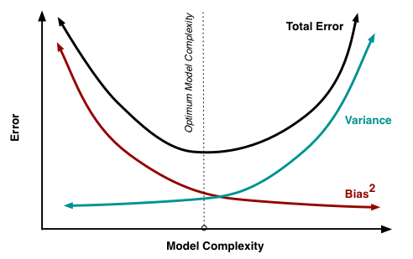
Bias vs Variance
Notes:
Next: plots of lines through data

Slide 51
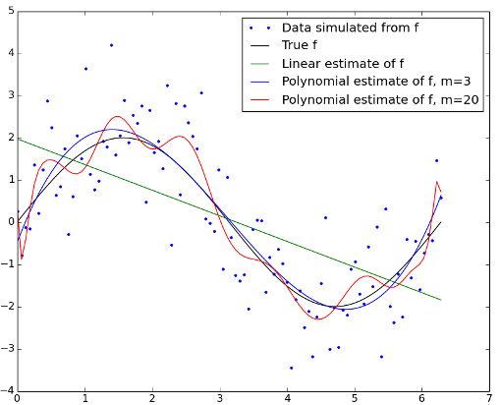
Bias vs Variance
Notes:
Next up: MATH and FORMULAS - how we find these lines and our magical coefficients

Slide 52
Math

Slide 53
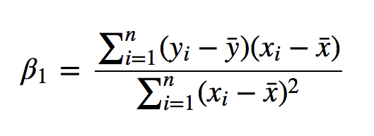

Slide 55
Sum
Sum

Slide 56
Sum
Sum

Slide 57
Sum
(y - mean of y)(x - mean of x)
Sum

Slide 58
Sum
(y - mean of y)(x - mean of x)
Sum
(x - mean of x)²

Slide 59
Simple
Linear Regression
Notes:
One predictor vs one target

Slide 60
y = x

Slide 61


Slide 63
y = -x

Slide 64
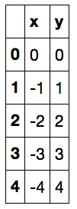

Slide 65
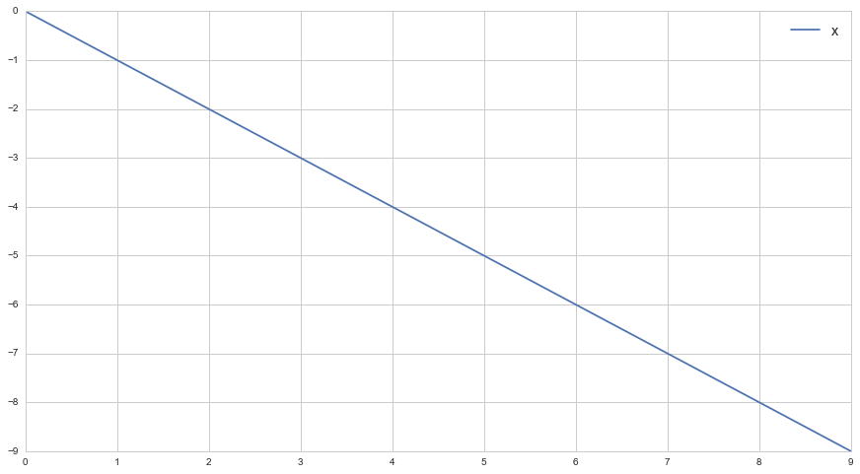

Slide 66
Deterministic (or functional) relationships

Slide 67
Deterministic (or functional) relationships
are fixed and predict their data exactly.
Notes:
And they don’t need us.

Slide 68
F = (9/5)C + 32

Slide 69
Converting Celsius to Fahrenheit
°F = (9/5)°C + 32

Slide 70
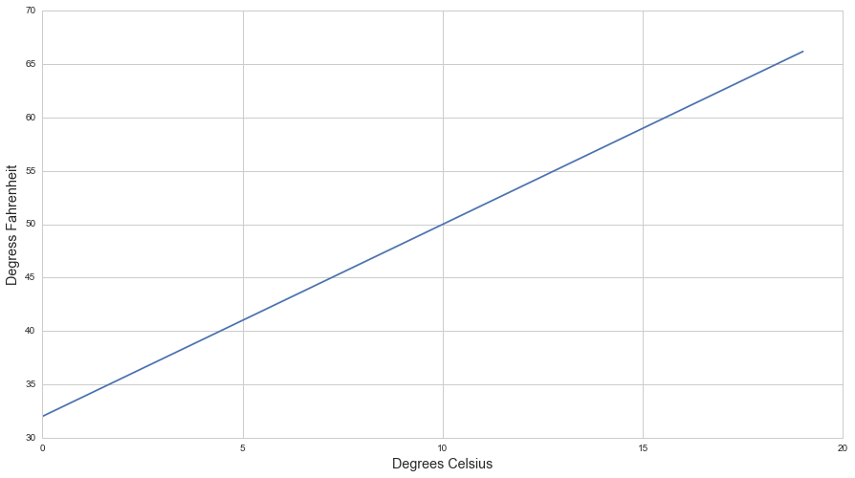
Fahrenheit = 32.0° - 66.2°
Celsius = 0° - 19°
Notes:
Next up: show the y-intercept

Slide 71
Converting Celsius to Fahrenheit
°F = (9/5)°C + 32

Slide 72
Converting Celsius to Fahrenheit
°F = (9/5)°C + 32
y = mx + b

Slide 73
y = mx + b
y = target variable

Slide 74
y = mx + b
y = target variable
x = predictor variable

Slide 75
y = mx + b
y = target variable
x = predictor variable
m = coefficient

Slide 76
y = mx + b
y = target variable
x = predictor variable
m = coefficient
b = y intercept

Slide 77
y = mx + b + ∈
Notes:
NOTE: I.e, the “loss” part of our function
NEXT: a real world example of a deterministic relationship in this slope formula

Slide 78
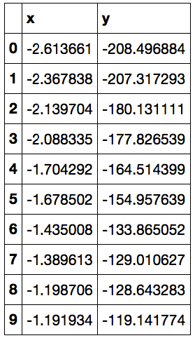
“Observed data”
(functionally generated with added random noise)
Notes:
NOTE: this is simple linear regression - one predictor and one dependent.

Slide 79
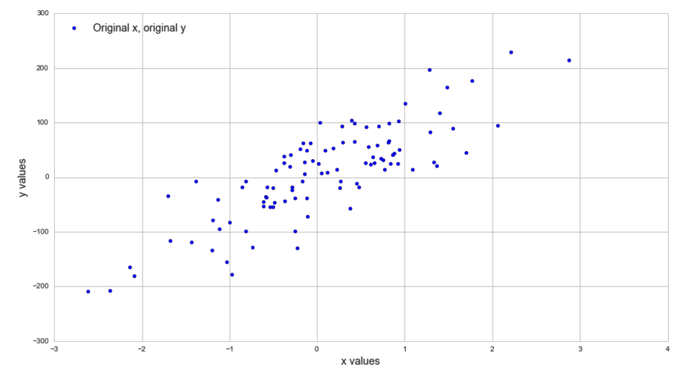
“Observed data”
(functionally generated with added random noise)
Notes:
Somewhere need to note that this is simple linear regression - one predictor and one dependent.

Slide 81
y = mx + b

Slide 82
-208.496884 = mx + b
y = mx + b

Slide 83
-208.496884 = m(-2.613661) + b
y = mx + b

Slide 84
from sklearn.linear_model import LinearRegression
lr = LinearRegression()
lr.fit(x,y)

Slide 85
from sklearn.linear_model import LinearRegression
lr = LinearRegression()
lr.fit(x,y)
print lr.coef_
print lr.intercept_
[72.72244833]
3.07326447646

Slide 86
ŷ = 72.73(x) + 3.072
y = mx + b

Slide 87
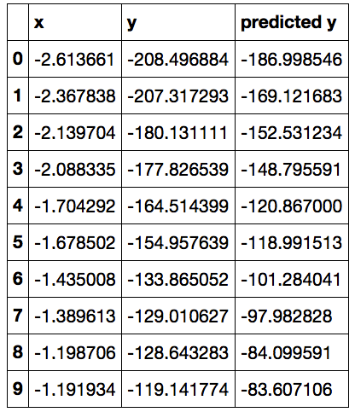
ŷ = 72.73(x) + 3.072
y = mx + b

Slide 88
ŷ = 72.73(x) + 3.072
y = mx + b

Slide 89
ŷ = 72.73(x) + 3.072
y = mx + b

Slide 90
ŷ = 72.73(x) + 3.072
y = mx + b

Slide 91
ŷ = 72.73(x) + 3.072
y = mx + b

Slide 92
y = mx + b + ∈

Slide 93
y = mx + b + ∈
Notes:
NOTE: two types of error - irreducible and reducible
Reducible = haven’t found all the signal, haven’t minimized your loss
Irreducible = normal randomness, chaos, life, the universe, the 2nd law of thermodynamics, etc.

Slide 94
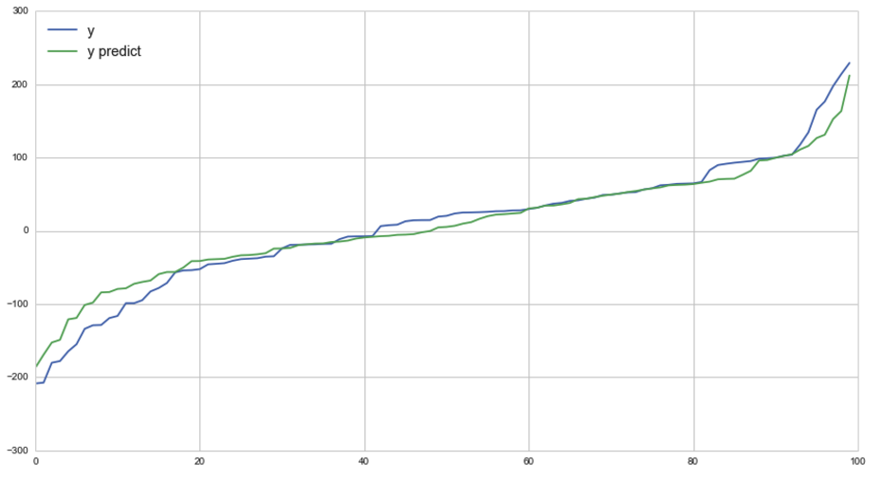

Slide 95
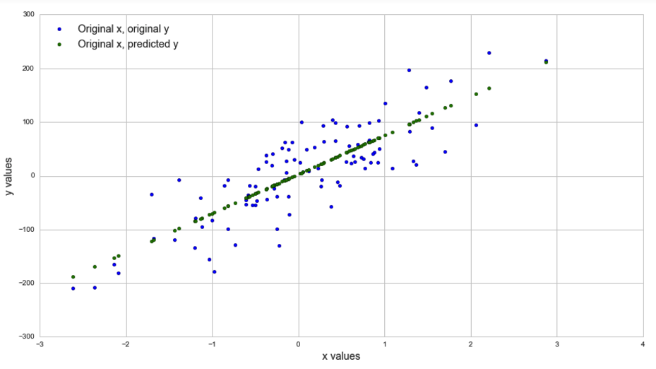
Notes:
NOTE: Since this is literally linearly related data with generated noise thrown in, any attempt to further fit this data would simply be modeling noise, not signal.

Slide 96
Measuring Accuracy

Slide 97
Accuracy
Score
Notes:
The simplest method is calling the score of your regression function.

Slide 98
from sklearn.linear_model import LinearRegression
lr = LinearRegression()
lr.fit(x,y)
print lr.coef_
print lr.intercept_
[72.72244833]
3.07326447646
lr.score(x,y)
0.89193846362
Notes:
So that’s something to talk about at tea parties.

Slide 99
Accuracy
Score
Plot your residuals

Slide 100
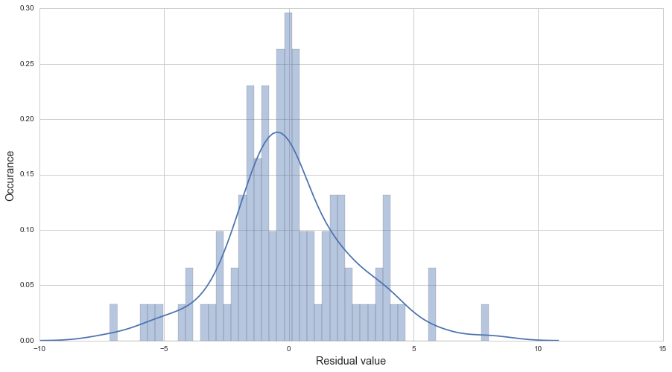
Accuracy
Notes:
If you’ve truly captured all the signal in your data, the result should be irreducible error, aka “noise”. By definition, in a data set that works with linear regression’s assumptions of standard distribution, the irreducible error part should be random and normally distributed.

Slide 101
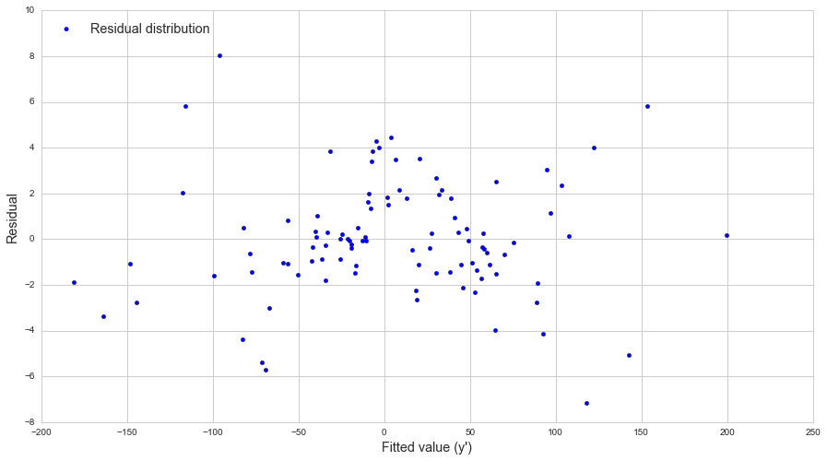
Accuracy
Notes:
They should be centered around zero. And shouldn’t indicate any trend.
Plotting your data and inspecting it visually is never a bad idea, both before and after your regression process.
UP NEXT: using math. How gauche.

Slide 102
Accuracy
Score
Plot your residuals
R² and Adjusted R²

Slide 103
Notes:
Our residuals, or errors are represented

Slide 104
SUM(y - ŷ)²
Notes:
Our residuals, or errors are represented

Slide 105
Residual Sum Squares = SUM(y - ŷ)²

Slide 106
Notes:
Adding the squares of these values will be a larger number.

Slide 107
SUM(y - ȳ)²

Slide 108
Total Sum Squares = SUM(y - ȳ)²
Notes:
What does all this have to do with R squared? I’m glad you asked.

Slide 109
RSS [SUM(y - ŷ)²]
R² = 1 -
TSS [SUM(y - ȳ)²]
Notes:
You can think of this as your loss compared to the loss incurred from simply taking the expected value. And since we’re trying to minimize our loss, if RSS = 0, then 1- 0 would be 1. So a perfect R squared score is 1. So you’re looking for a score as close to 1 as possible. Obviously the bigger the sum of your residual errors, the larger the number that results from the division and the lower the R sq score.
Is it possible to have a -1 score? Yes, but only if your line was so bad it’s worse than simply taking the mean.

Slide 110
RSS [SUM(y - ŷ)²]
R² = 1 -
TSS [SUM(y - ȳ)²]
works for simple linear regression
Notes:
You can think of this as your loss compared to the loss incurred from simply taking the expected value. And since we’re trying to minimize our loss, if RSS = 0, then 1- 0 would be 1. So a perfect R squared score is 1. So you’re looking for a score as close to 1 as possible. Obviously the bigger the sum of your residual errors, the larger the number that results from the division and the lower the R sq score.
Is it possible to have a -1 score? Yes, but only if your line was so bad it’s worse than simply taking the mean.

Slide 111
RSS [SUM(y - ŷ)²]
R² = 1 -
TSS [SUM(y - ȳ)²]
fine for simple linear regression
has problems with multiple linear regression
Notes:
You can think of this as your loss compared to the loss incurred from simply taking the expected value. And since we’re trying to minimize our loss, if RSS = 0, then 1- 0 would be 1. So a perfect R squared score is 1. So you’re looking for a score as close to 1 as possible. Obviously the bigger the sum of your residual errors, the larger the number that results from the division and the lower the R sq score.
Is it possible to have a -1 score? Yes, but only if your line was so bad it’s worse than simply taking the mean.

Slide 112
y = m₁x₁ + b + ∈
Notes:
Remember that linear regression is additive. We can add as many features as we like to determine our “line”, albeit in a multi-dimensional space.

Slide 113
y = m₁x₁ + m₂x₂ + b + ∈

Slide 114
y = m₁x₁ + m₂x₂ + b + ∈
Features

Slide 115
y = m₁x₁ + m₂x₂ + b + ∈
Coefficients
Notes:
The value of any feature is represented by it’s coefficient - it’s beta.

Slide 116
Regression
Estimate the relationships between predictor and target variables
Incurs loss as a result of this estimation
Attempts to minimize loss

Slide 117
Regression
Estimate the relationships between predictor and target variables
Incurs loss as a result of this estimation
Attempts to minimize loss

Slide 118
y = m₁x₁ + m₂x₂ + b + ∈
Coefficients
Notes:
So if the second feature doesn’t add any value to the ability of the algorithm to minimize the loss function, what’s it going to do with the beta for that coefficient? Essentially, set it to zero.

Slide 119
y = m₁x₁ + 0x₂ + b + ∈
Coefficients
Notes:
So we have a problem: once we add more than one feature, our Rsq begins losing its validity as a measure of “goodness” of fit. In fact, any variable you can may randomly have some slight correlation with our y, so it may even slightly minimize your error further and thus increase your rsq. So Rsq can never go down, only stay the same or go up. Obviously this isn’t helpful for knowing whether your added features are increasing your predictive ability or not.

Slide 120
n - 1
Adj R² = 1 - (1 - R²)
n - p - 1
Notes:
Next: add explanations for n and p

Slide 121
n - 1
Adj R² = 1 - (1 - R²)
n - p - 1
n = sample size
p = number of predictors

Slide 122
n - 1
Adj R² = 1 - (1 - R²)
n - p - 1
n = sample size
p = number of predictors

Slide 123
n - 1
Adj R² = 1 - (1 - R²)
n - p - 1
n = sample size
p = number of predictors
Notes:
As this number gets smaller...

Slide 124
n - 1
Adj R² = 1 - (1 - R²)
n - p - 1
n = sample size
p = number of predictors
Notes:
This ratio gets larger, which in turn makes...

Slide 125
n - 1
Adj R² = 1 - (1 - R²)
n - p - 1
n = sample size
p = number of predictors
Notes:
This result larger, which drives down your Adjusted Rsq. So adding features or predictors will drive down your Adjusted Rsq. But...

Slide 126
n - 1
Adj R² = 1 - (1 - R²)
n - p - 1
n = sample size
p = number of predictors
Notes:
Also remember that even just random noise in your added predictors can push Rsq up. And certainly if you added a predictor that greatly increased the accuracy of your predictions that would push your regular Rsq up. And of course, either of those would make...

Slide 127
n - 1
Adj R² = 1 - (1 - R²)
n - p - 1
n = sample size
p = number of predictors
Notes:
This number smaller, which drives your adjusted Rsq...up.
So it becomes a battle between the penalty you incur for adding additional predictors or features, and the value they can bring to your Rsq. Adjusted Rsq rewards only adding predictors that strongly contribute to your accuracy, and thus is a better measure of goodness of fit than just Rsq, when you have more than one predictor or feature.

Slide 128
Assumptions
or: Is That A Linear Regression in Your Pocket or Are You Just Happy to See Me?

Slide 129
That your data are linearly correlated.
Notes:
Makes sense - no use in using a linear regression if your data can’t be meaningfully explained with such a relationship.

Slide 130
That your data are linearly correlated.
That the weights of the predictor values can be summed meaningfully.
Notes:
As mentioned before, linear regression is additive with it’s predictors - so those need to be predictive in conjunction with one another.

Slide 131
That your data are linearly correlated.
That the weights of the predictor values can be summed meaningfully.
No linear dependence, aka multicollinearity.
Notes:
The regressors or predictors in your X set must all be linearly independent. Multicollinearity won’t affect your overall predictive accuracy, but it severely compromises your ability to indicate specifically how much each predictor contributes to the function. In other words, your individual coefficients become unreliable indicators.

Slide 132
That your data are linearly correlated.
That the weights of the predictor values can be summed meaningfully.
No linear dependence, aka multicollinearity.
Homoscedasticity

Slide 134
Notes:
The variance of the data around it’s mean is consistent.

Slide 136
Notes:
Now there’s some additional trend going on in your data and this will need to be accounted for - or in other words, controlled for.
NEXT: Final Thoughts

Slide 137
Final Thoughts

Slide 138
“Correlation doesn't imply causation...
Notes:
Last slide

Slide 139
Anscombe’s Quartet
Anscombe's quartet comprises four datasets that have nearly identical simple statistical properties, yet appear very different when graphed.
They were constructed in 1973 by the statistician Francis Anscombe to demonstrate both the importance of graphing data before analyzing it and the effect of outliers on statistical properties.
He described the graphs as being intended to attack the impression among statisticians that "numerical calculations are exact, but graphs are rough."
Notes:
Sounds like a lovely chamber orchestra, but it’s not.

Slide 140
Anscombe’s Quartet
All the summary statistics are close to identical:
The average x value is 9

Slide 141
Anscombe’s Quartet
All the summary statistics are close to identical:
The average x value is 9
The average y value is 7.50

Slide 142
Anscombe’s Quartet
All the summary statistics are close to identical:
The average x value is 9
The average y value is 7.50
The variance for x is 11 and the variance for y is 4.12

Slide 143
Anscombe’s Quartet
All the summary statistics are close to identical:
The average x value is 9
The average y value is 7.50
The variance for x is 11 and the variance for y is 4.12
The correlation between x and y is 0.816

Slide 144
Anscombe’s Quartet
All the summary statistics are close to identical:
The average x value is 9
The average y value is 7.50
The variance for x is 11 and the variance for y is 4.12
The correlation between x and y is 0.816
A linear regression (line of best fit) follows the equation y = 0.5x + 3
Notes:
You would expect data that shared these characteristics to essentially look the same when graphed...

Slide 145
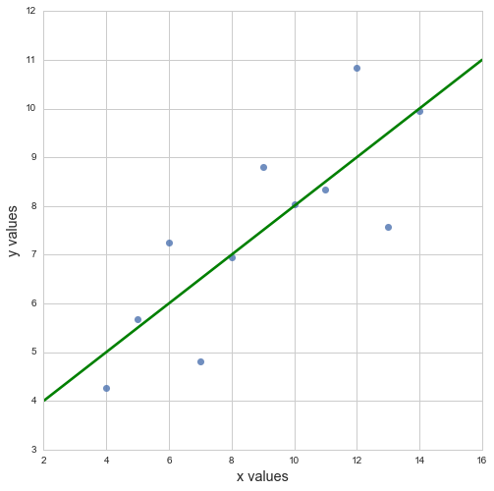
Anscombe’s Quartet

Slide 146
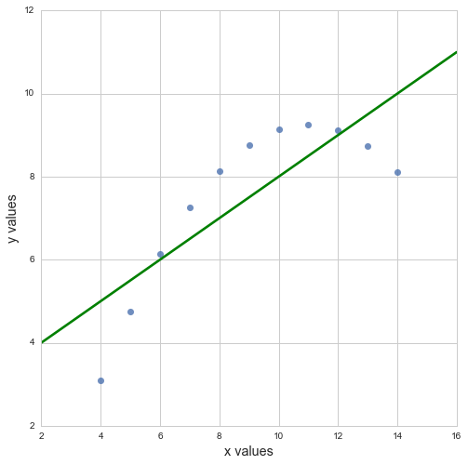
Anscombe’s Quartet

Slide 147
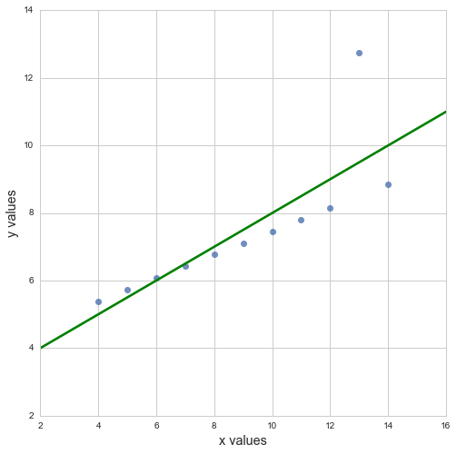
Anscombe’s Quartet

Slide 148
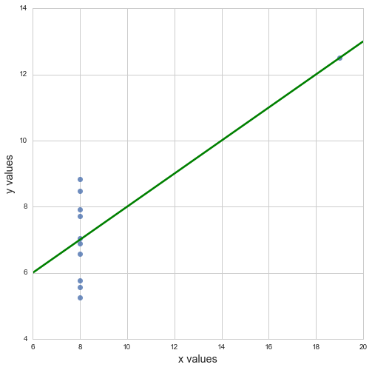
Anscombe’s Quartet

Slide 149
Anscombe’s Quartet
Notes:
Next: Thus, damn lies.

Slide 150
"There are three kinds of lies: lies, damned lies, and statistics."
British Prime Minister Benjamin Disraeli
Notes:
Last slide - made famous by Mark Twain
Next: Spurious correlation

Slide 151
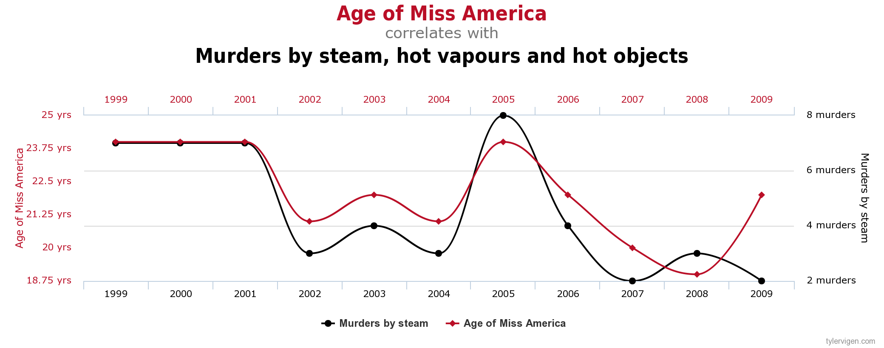
Notes:
Last slide

Slide 152
“Correlation doesn't imply causation...
Notes:
Last slide

Slide 153
“Correlation doesn't imply causation…
...but it does waggle its eyebrows suggestively and gesture furtively while mouthing 'look over there'."
- Randall Munroe, XKCD
Notes:
Last slide

Slide 154

Notes:
Last slide

